Slide 1
Superstore Sales Forecasting
Final Project Presentation - DSCI 631 Applied Machine Learning
Group 03
Hemachandar Nagarajan, Padma Priya Jayaraj, Pinkesh Nayak

Slide 2

Agenda
Introduction to Dataset
Methodology
Exploratory Data Analysis
Time Series Analysis
Limitations
Recommendations And Conclusion
Group Members Contribution

Slide 3
Introduction to Dataset
Dataset: https://www.kaggle.com/rohitsahoo/sales-forecasting
Data Description: Retail dataset of a global superstore for 4 years
Data Size: 9800 rows and 18 features (columns)

Slide 4
Why analyze Superstore Sales Data
To make location and other resource level decisions
To identify the new or growing product potential
To help set budgets
To provide a basis for a monitoring system
To aid in production planning
Forecast helps financial analysts to value a company
To set objectives and evaluate performance

Slide 5
Features of the Dataset
Variable Name | Datatype | Description
Row ID | Numerical | ID that refers to the specific piece being reviewed
Order ID | Categorical | ID that refers to the specific piece being ordered
Order Date | Date | Date of the order
Ship Date | Date | Shipping date
Ship Mode | Categorical | Shipping Mode
Customer ID | Categorical | ID that refers to the customer
Customer Name | Categorical | Name of the specific customer
Segment | Categorical | Segment through which the order is placed
Country | Categorical | Name of the country from where the order is placed
City | Categorical | Name of the city from where the order is placed
State | Categorical | Name of the state from where the order is placed
Postal Code | Categorical | Postal code from where the order is placed
Region | Categorical | Region from where order is placed
Product ID | Categorical | ID that refers to the specific product being ordered
Category | Categorical | Category to which the order belongs to
Sub-Category | Categorical | Sub-category to which the order belongs to
Product Name | Categorical | Name of the product being ordered
Sales | Numerical | Price of the product in US dollars

Slide 6
Methodology
Data Exploration | ❏ Exploratory Data Analysis ❏ Descriptive Analysis
Data Pre-processing | ❏ Checking for Missing Values ❏ Train-Test Split
Regression Model | ❏ Linear Regression ❏ Polynomial Regression
Time Series Model | ❏ ARIMA ❏ FBProphet ❏ SARIMAX

Slide 7
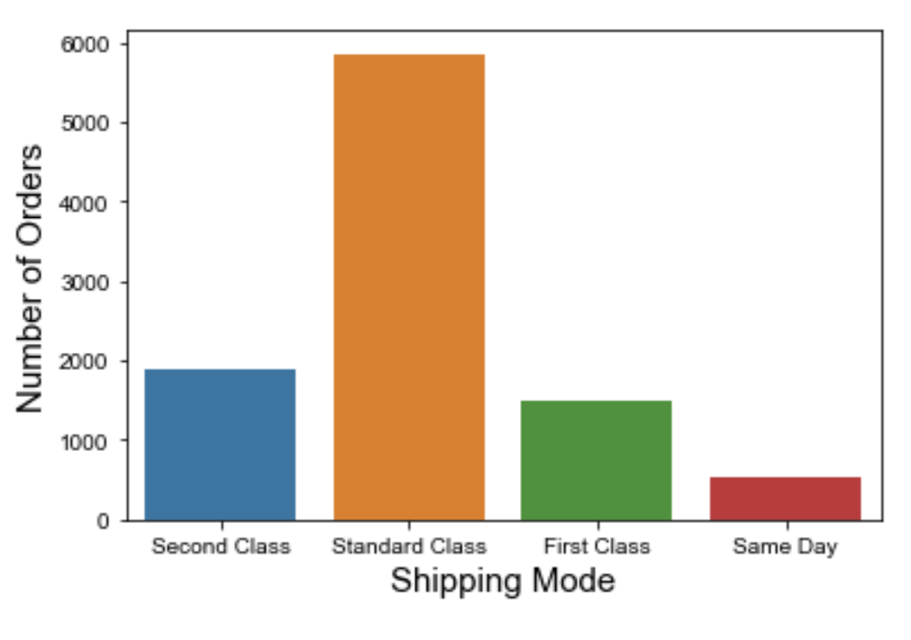
Customers interest on Shipping Mode
Most of the customers prefer standard shipping mode and very few prefer same day shipping because mostly standard shipping comes free of cost.

Slide 8
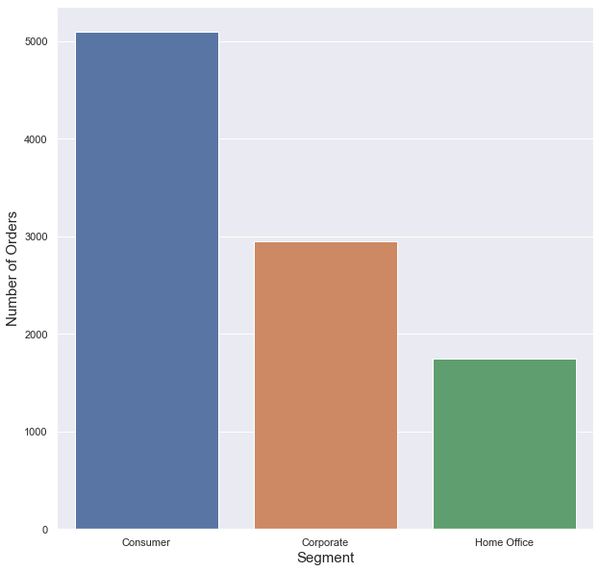
Number of orders placed by each segment
A large number of orders are from consumer segment followed by corporate segment.

Slide 9
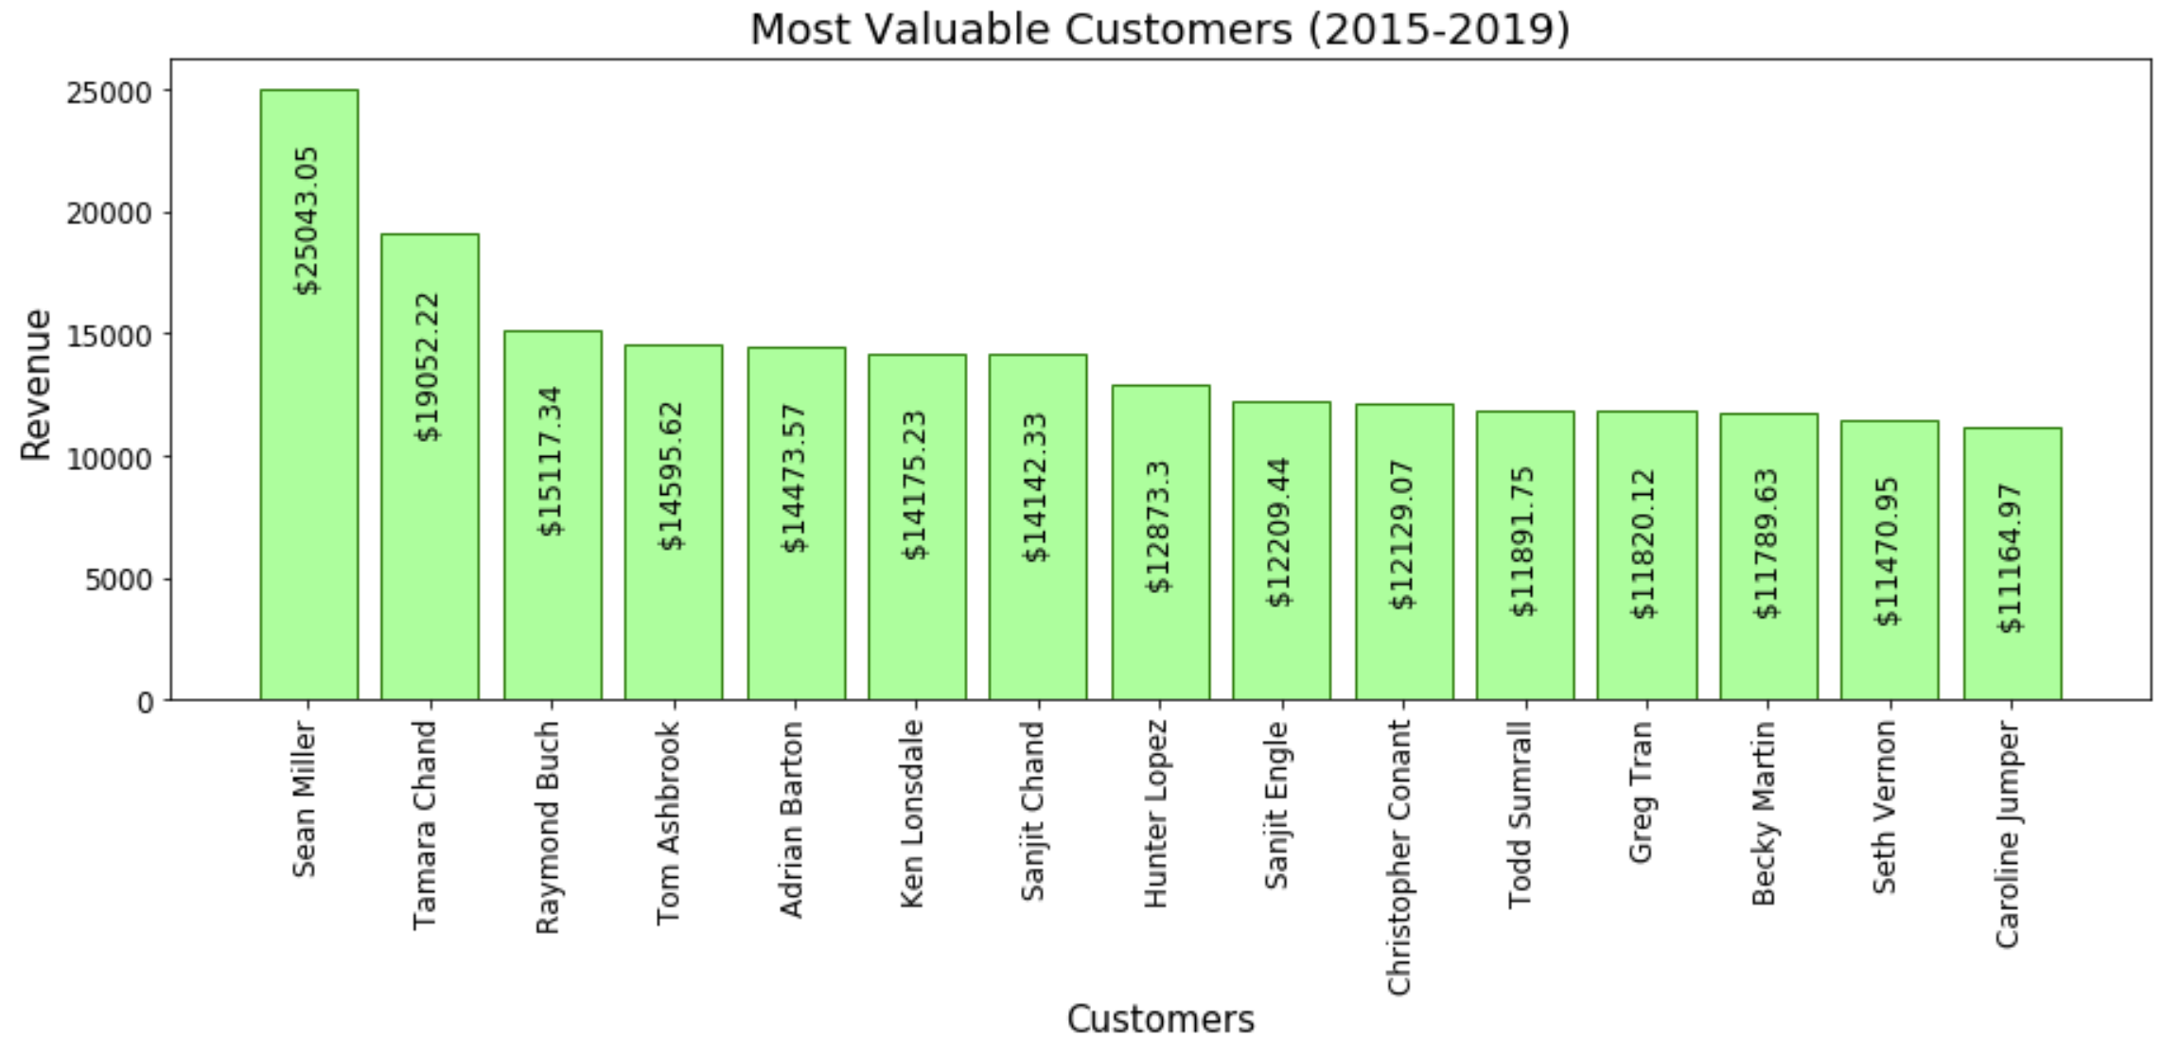
Most Valuable Customers Based on Revenue

Slide 10
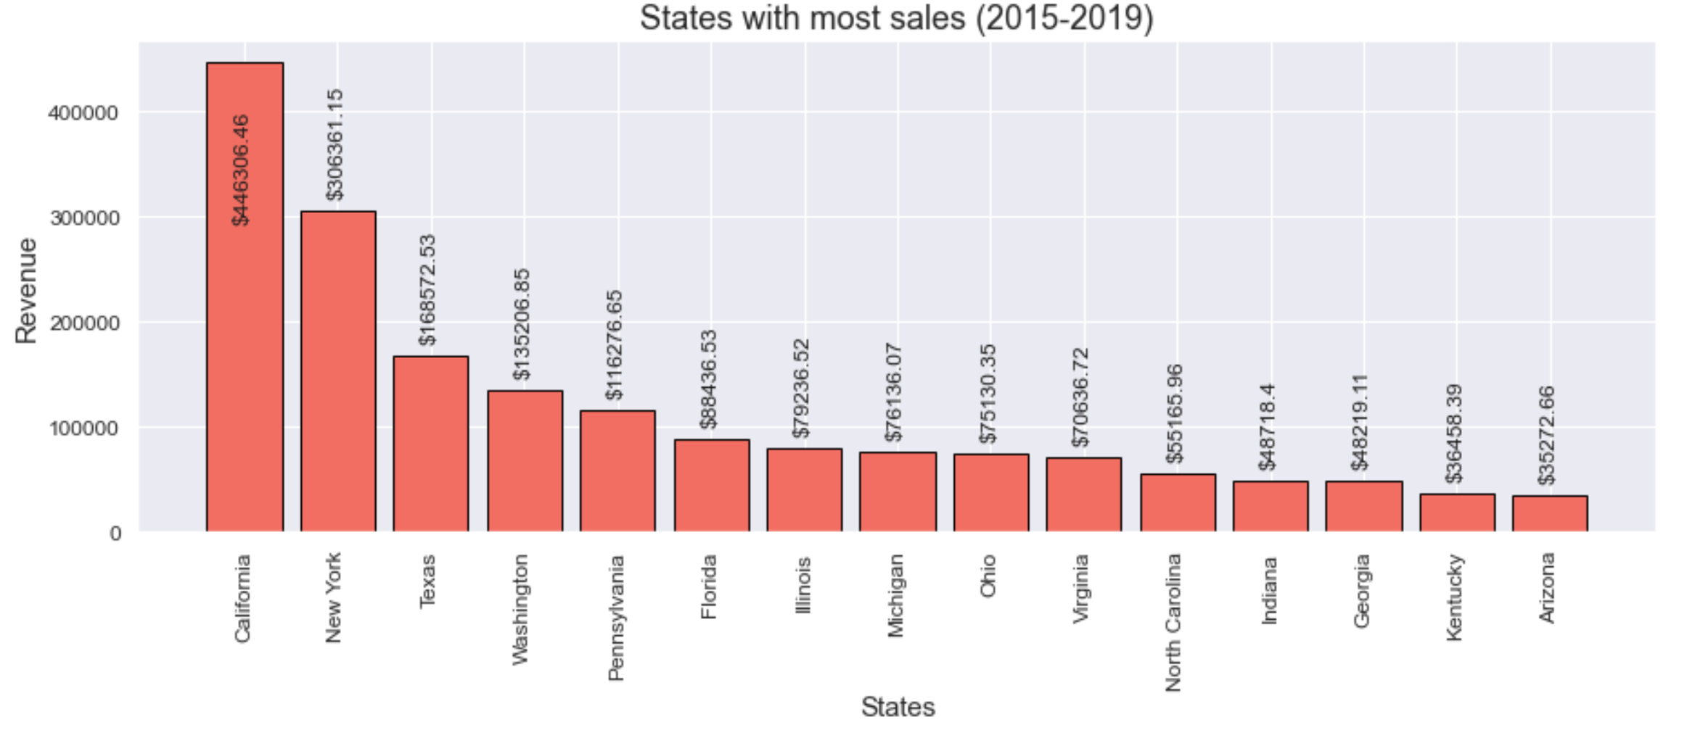
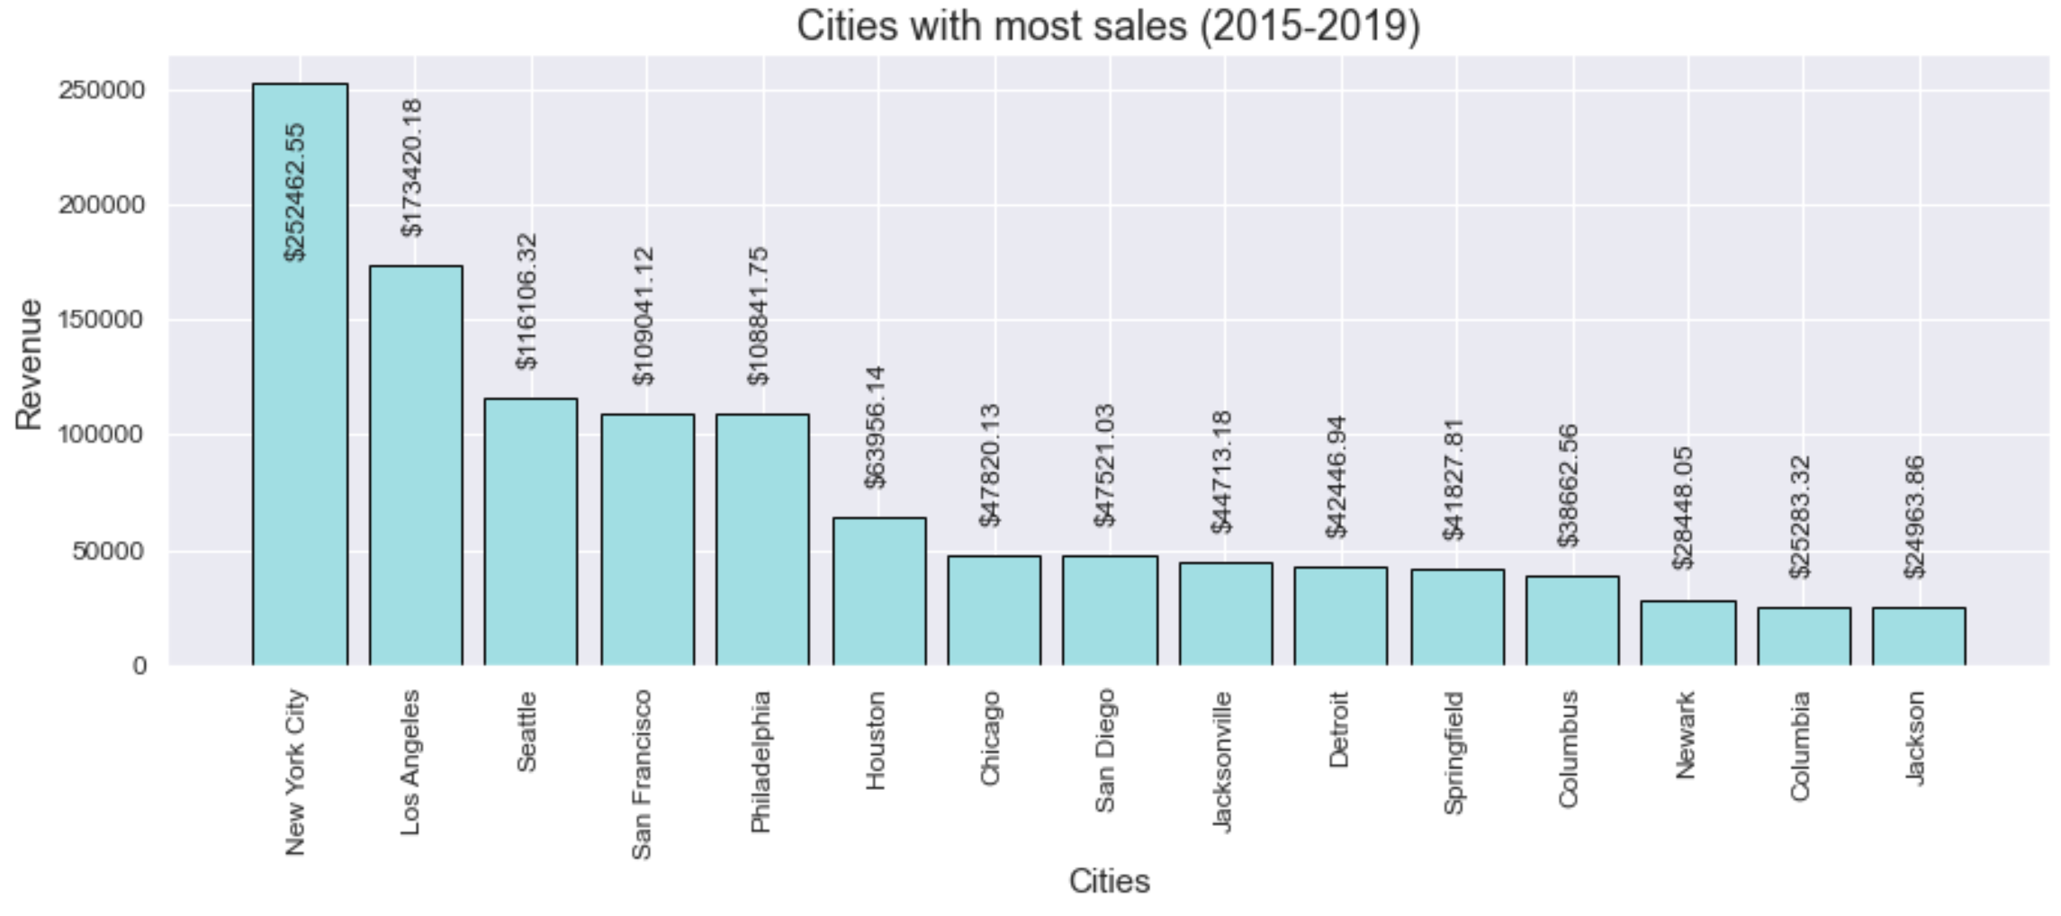
Sales- Top 15 States and Cities California state makes the highest sales and in the cities that makes more sales like Los Angeles, San Francisco, San Diego belongs to California

Slide 11
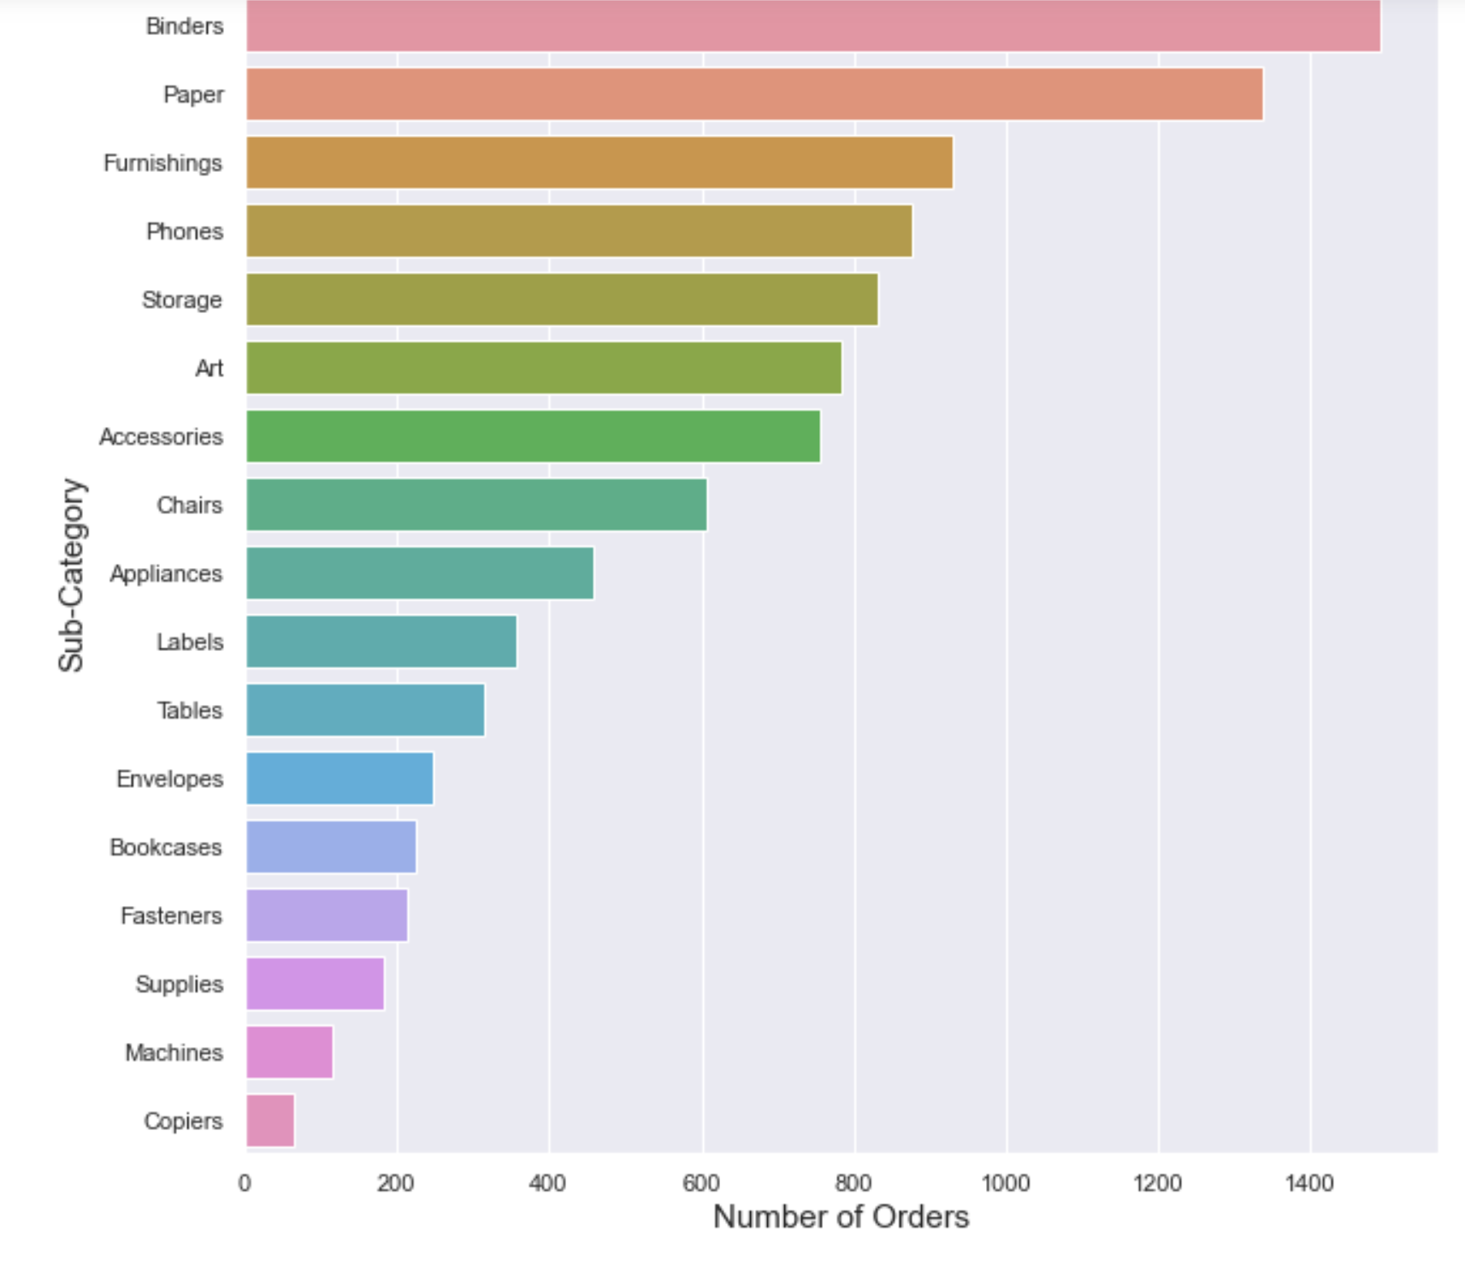
Number of orders placed by each subcategory
Most of the orders nearly 60.3% belongs to office supplies category, followed by Furniture 21.2% and Technology of 18.5%. So, the customers are more interested in buying office supplies from stores.

Slide 12
Fitting Regression Models
Linear Regression
Root Mean Square Error (RMSE) on train data: 641.08
Root Mean Square Error (RMSE) on test data: 591.45
Polynomial Regression
Root Mean Square Error (RMSE) on train data: 641.07
Root Mean Square Error (RMSE) on test data: 592.01
Adding month number in prediction
Root Mean Square Error (RMSE) on train data: 640.93
Root Mean Square Error (RMSE) on test data: 591.61

Slide 13
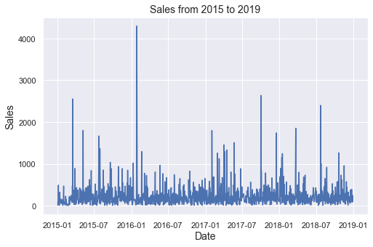
Time Series Analysis

Slide 14
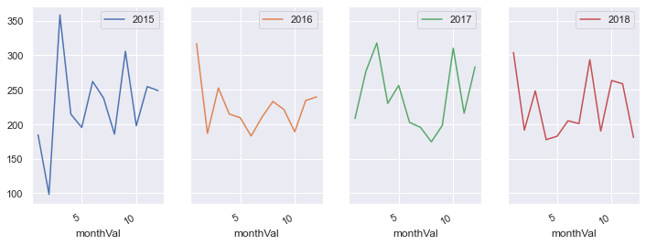
Time Series Analysis

Slide 15
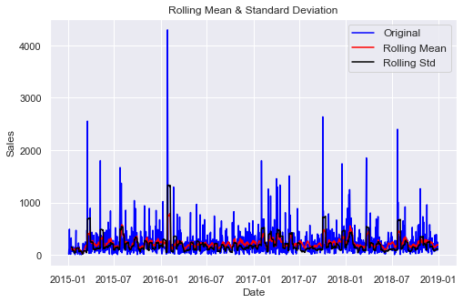
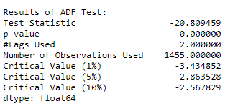
Check for Stationarity
The test statistic is smaller than the 0.1% critical values so we can say with 99.9% confidence that this is a stationary series.

Slide 16
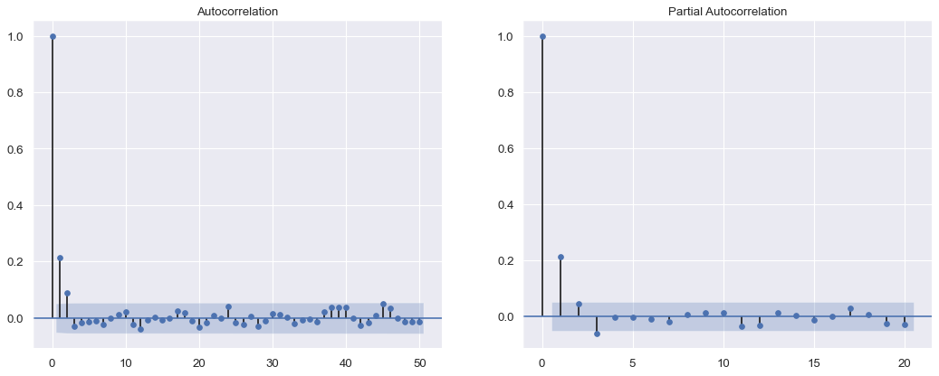
ARIMA (Auto Regressive Integrated Moving Average)
## AR model: p = 1, d = 1, q = 0
## MA model: p = 0, d = 1, q = 2
## ARIMA model: p = 1, d = 1, q = 2

Slide 17
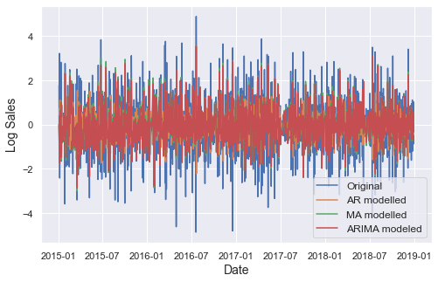


Slide 18
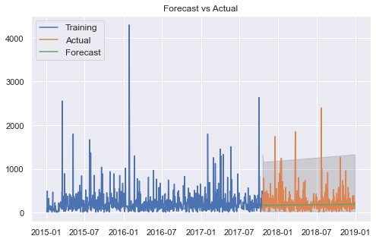
ARIMA model
Root Mean Square Error (RMSE) on train data: 5.29
Root Mean Square Error (RMSE) on test data: 5.16

Slide 19
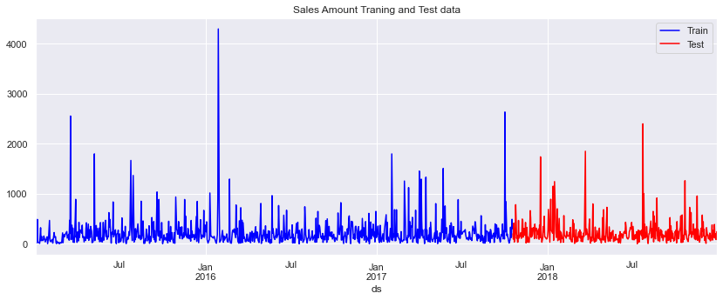
FBProphet
Decomposable time series model with three main model components: trend, seasonality, and holidays.

Slide 20
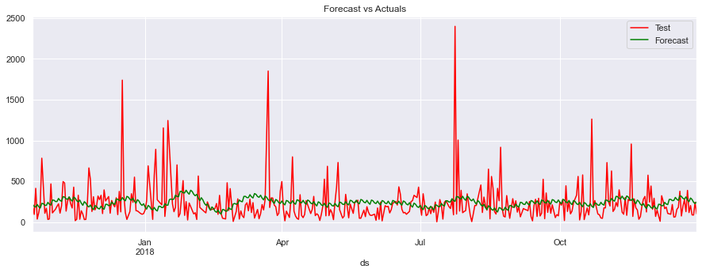
Initial Forecast
Root Mean Square Error (RMSE) on train data: 273.98
Root Mean Square Error (RMSE) on test data: 245.34
We can see from the above plot, that there is huge gap in prediction.
So, we need to optimize the model by adding other parameters like holidays, changepoints etc.

Slide 21
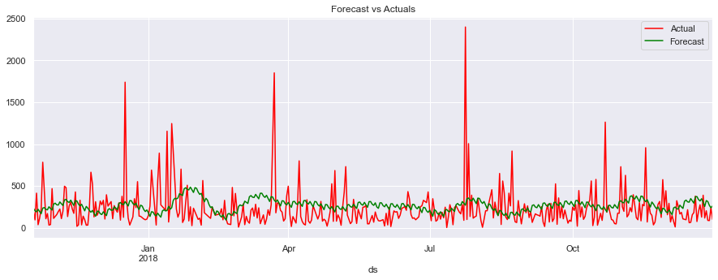
Hyperparameter Tuning
Root Mean Square Error (RMSE) on train data: 270.32
Root Mean Square Error (RMSE) on test data: 252.81

Slide 22
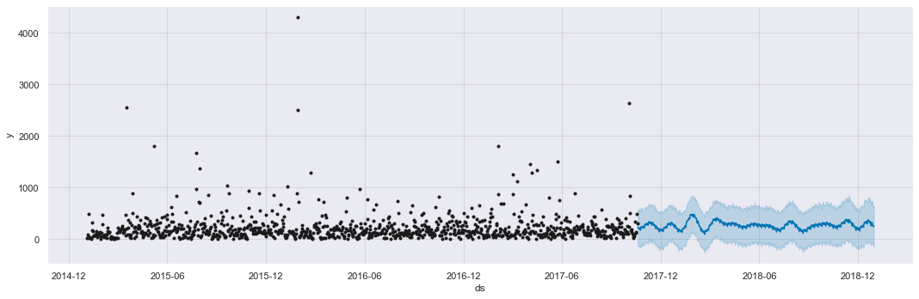
Final Forecast

Slide 23
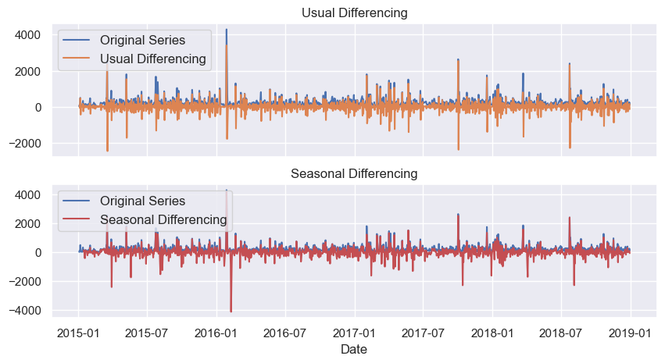
SARIMAX (Seasonal ARIMA model)

Slide 24
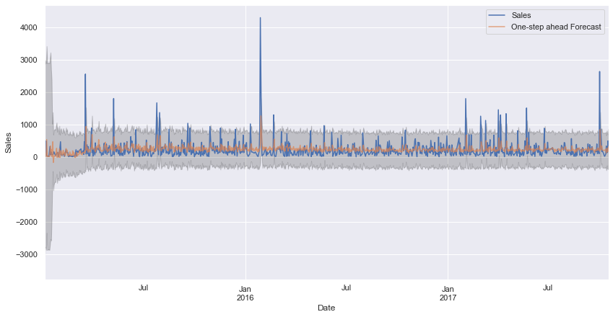
SARIMAX (Seasonal ARIMA model)
Root Mean Square Error (RMSE) on train data: 278.44
Root Mean Square Error (RMSE) on test data: 240.55

Slide 25
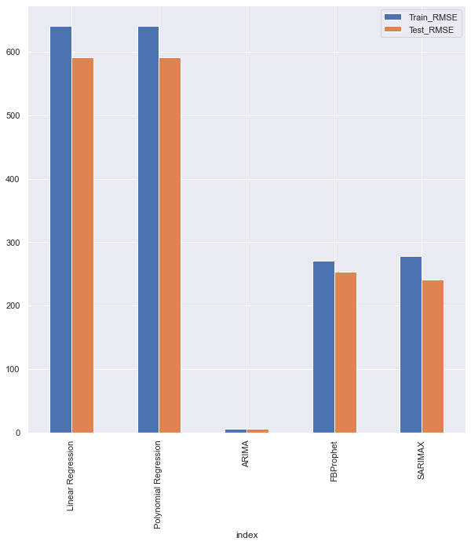
Performance Summary & Model Selection
Final Model (lowest RMSE):
ARIMA
RMSE on train data: 5.29
RMSE on test data: 5.16

Slide 26
Limitation
Analyzing the impact of Single Events. There are several events happening at the same time.
Past performance is no indication of future results since there are numerous factors that might affect the sales of the store.
The retail market is so dynamic and often affected by new products, promotions, seasonality and other changes.

Slide 27
Conclusion
Forecasting helps in understanding the customers purchase behavior, thereby helps the stores in resource allocation
Predicting the future sales helps in resolving any future demand problems and enables customer trust on stores
Based on the historic data provided, it not only helps in forecasting future sales but also helps the stores in arranging campaigns and increase the product sales

Slide 28
Group Members Contribution
Padma Priya Jayaraj- Data Preprocessing, EDA
Hemachander Nagarajan- Arima, Prophet, EDA
Pinkesh Nayak- Sarima, Linear Regression, Polynomial Regression, EDA

